Slide 1



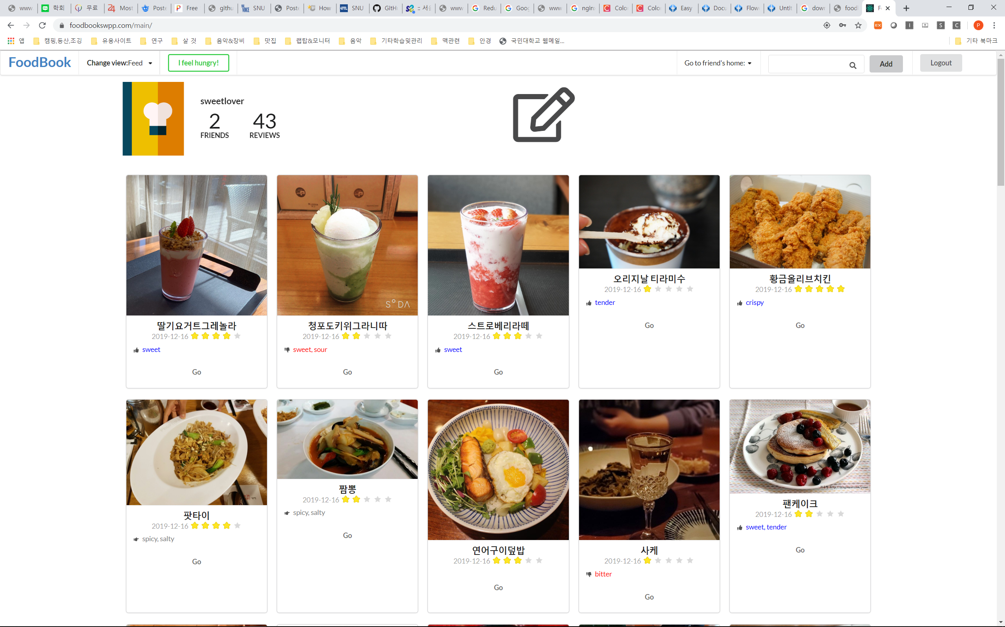

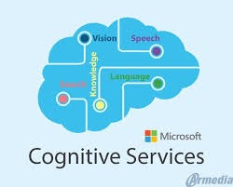


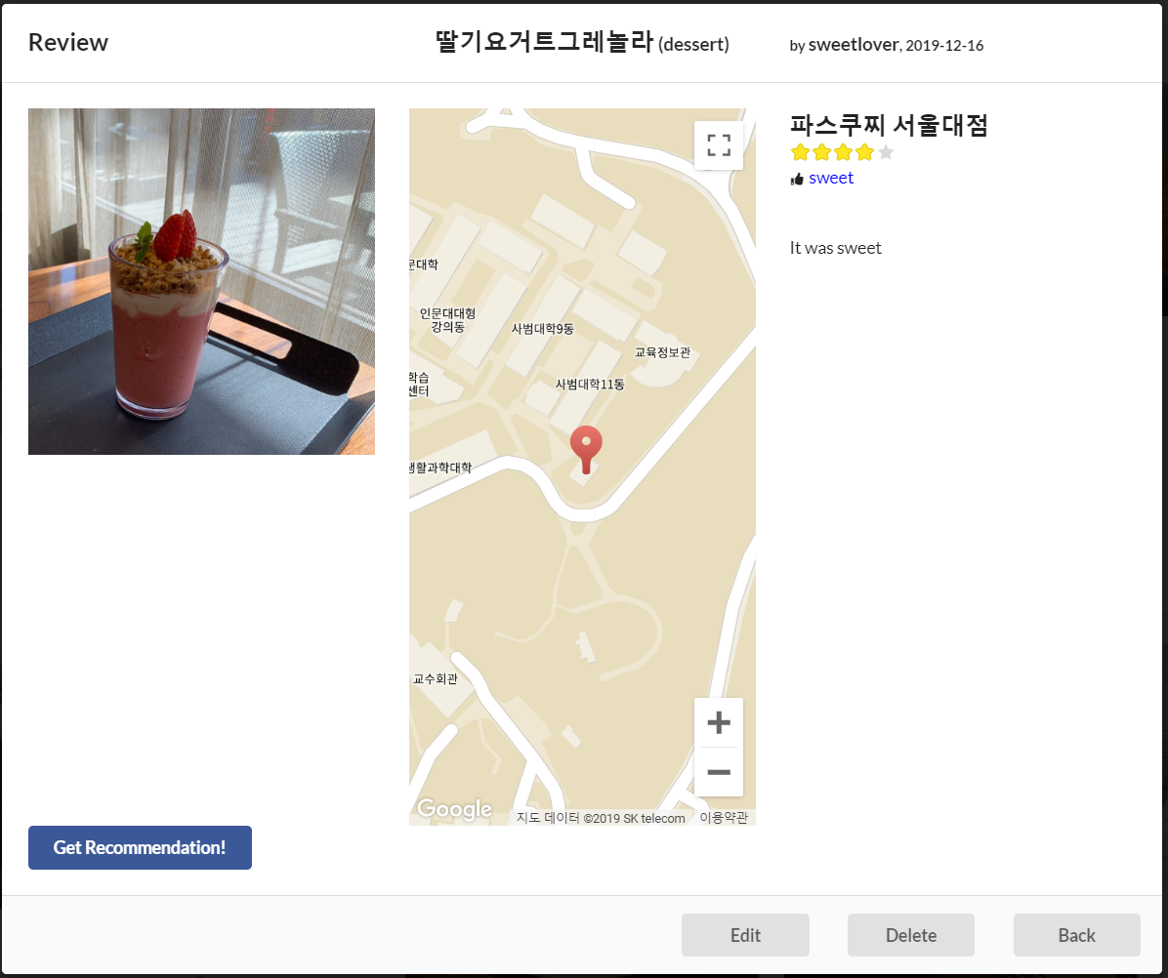
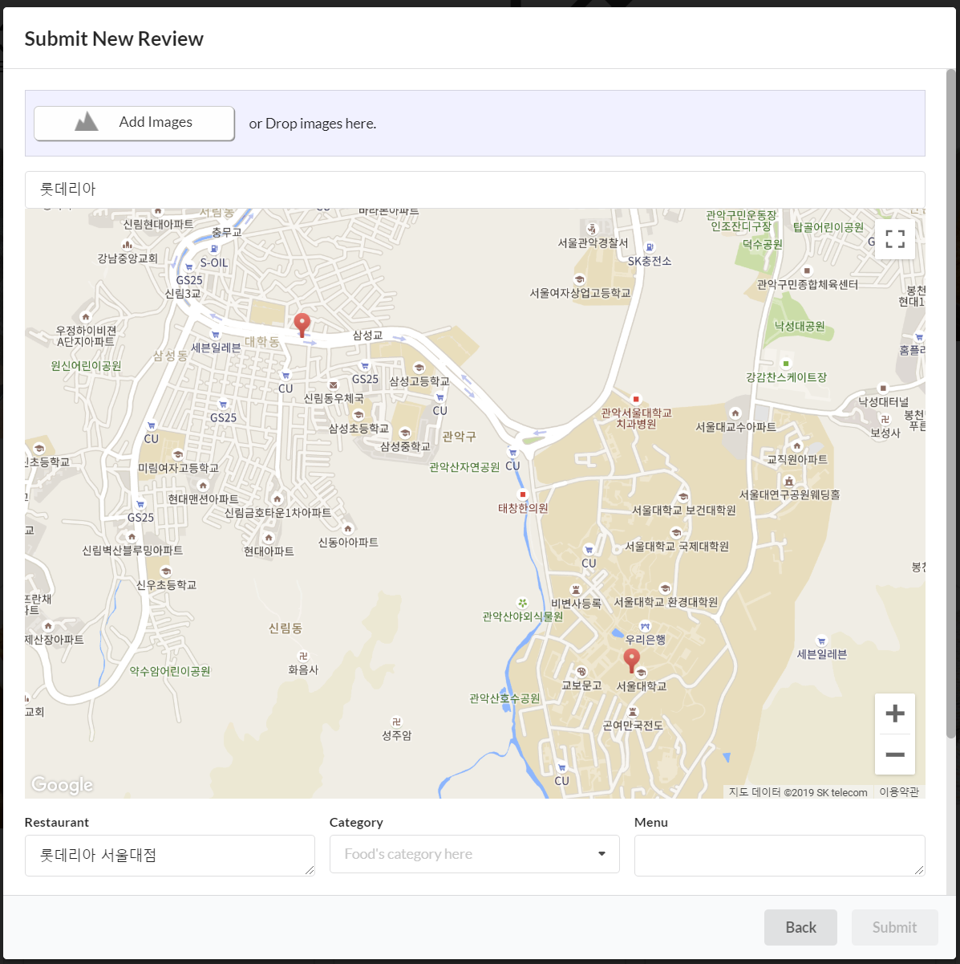
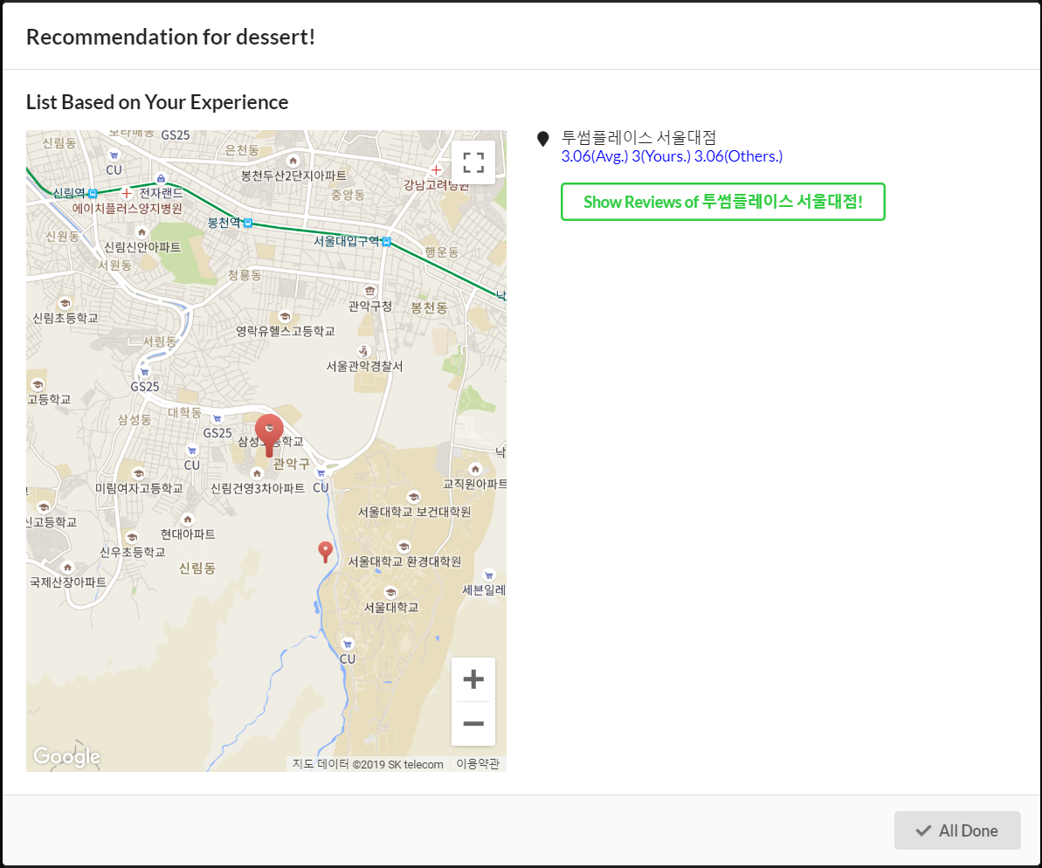
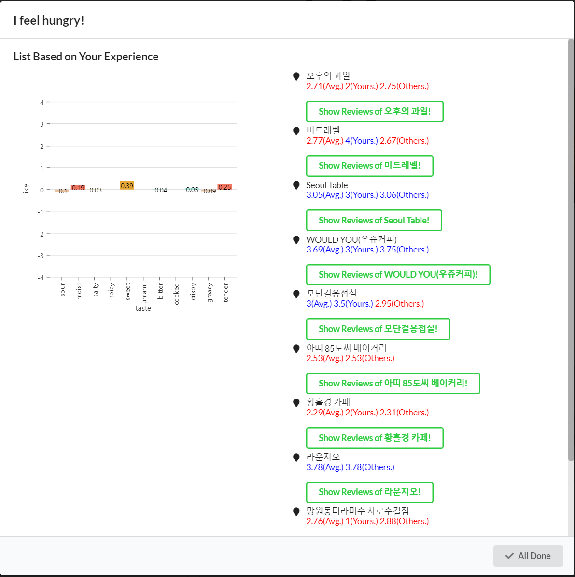




FoodBook
Why are you depending solely on other's taste?
Team 10 | 강태호 | 남재호 | 차병희 | 최지혁
Introduction
This service aims to personalize the aesthetic experience on eating, to group people with similar preferences based on the personalized experience and to provide services that are more optimized for each user. Using the food pictures and brief information provided by the user, the service analyzes reviews of the food and categorizes the individual food tastes. Based on the data, our service can recommend appropriate restaurants for individuals when they eat new food or reorder the food they ate.
Features
System Architecture
Review uploading system
Share reviews with friends
Location based recommendation
User-taste based recommendation
Redux State
State/Props
UI
Reducer
Action
Tagging & Recommendation
Main Page
Tagging
tagging(text): tag = {} for sentences in text: sentiment = sentiment_analysis(sentence) # MS cognitive service for word in sentence: if word is adjative or past participle verb: if word has adverb: # by stanford dependency parser tag[adverb + word] = sentiment else: tag[word] = sentiment return tag | Cs
Updating User and Menu object
{‘sweet’: 2, ‘not spicy’: 3}
Review Detail
Modals
Review Submit
Prepare the list for words of taste,
And synonyms, antonyms for each word
Recommendation
Filter tag word that is in the list
Menu
User
Does word have negation?
Does word have negation?
yes
no
yes
no
Future works
$$taste=\frac{taste∗N−1}{N+1}$$
$$taste=\frac{taste∗N+1}{N+1}$$
$$taste=\frac{taste∗N−sentiment}{N+1}$$
$$taste=\frac{taste∗N+sentiment}{N+1}$$
Try other models in NLP to improve tagging( ex: BERT)
Try recommendation considering user’s diet
Extend the range of service(ex: wine review)
{‘sweet’: 1, ‘spicy’: -1 …}
{‘sweet’: 2, ‘spicy’: -3 …}
Menu.taste
Dot product
User.taste
Recommendation

